Slide 1
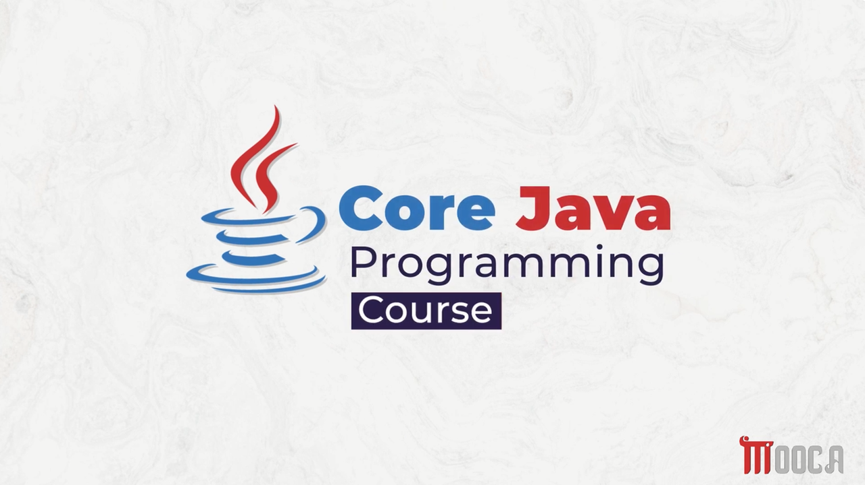

Slide 2
✍Lecture 3:
Primitive Data types .
Literals in java .
Variables .
Type Casting .
Arrays .
Lab 3.

Slide 3
✍Lecture 4 :
The Arithmetic and Bitwise Operators
The Relational and Boolean Logical Operators
The Ternary and instanceof Operators
Tha Arrow Operator and Lambda Expression
Selection Statements
Iteration Statements
Jump Statements
Java String
String Methods
StringBuffer, StringBuilder and StringTokenizer
Lab 4 .

Slide 4
✍Lecture 5 :
Wrapper Classes
Annotations
Annotations Basics
Lab 5 .

Slide 5
✍What is a Package?
A package is a group of related classes and interfaces.
Packages provide:
Organization
Naming
Access control

Slide 6
✍Why Packages ?
As a Java project grows, it may contain many classes.
Packages help us to:
Organize related classes and interfaces.
Avoid naming conflicts.
Control access to classes and members.
Make large projects easier to manage.

Slide 7
✍Naming Conflicts
Different packages can contain classes with the same name.
school.Student
university.Student
Both classes are named Student

Slide 8
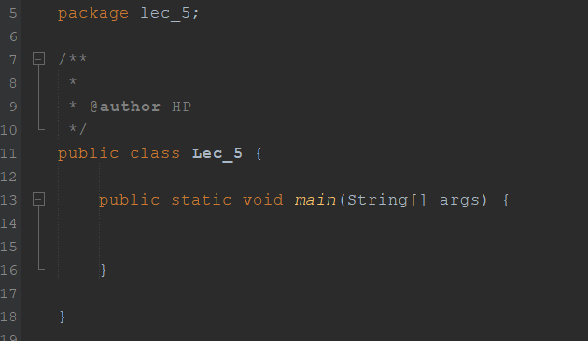

✍Defining a Package
Use the package keyword at the beginning of the Java file.
All classes declared in this file belong to the specified package.

Slide 9
✍Package Hierarchy
Packages can be organized into multiple levels.
com
└── company
└── school
├── Student
└── Teacher
com.company.school.students

Slide 10
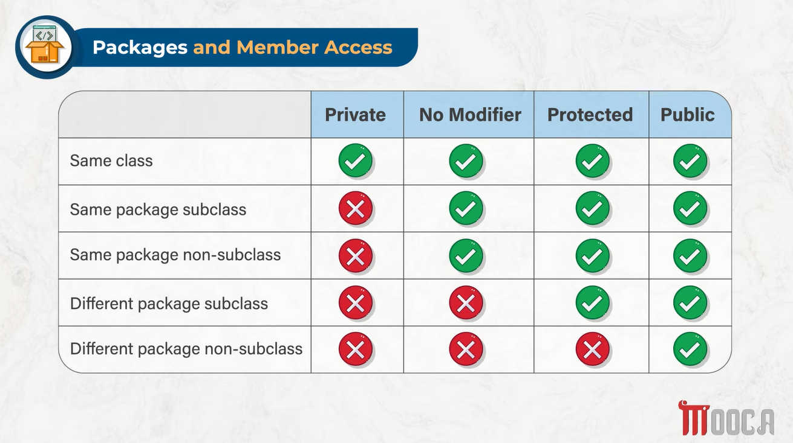



Slide 11
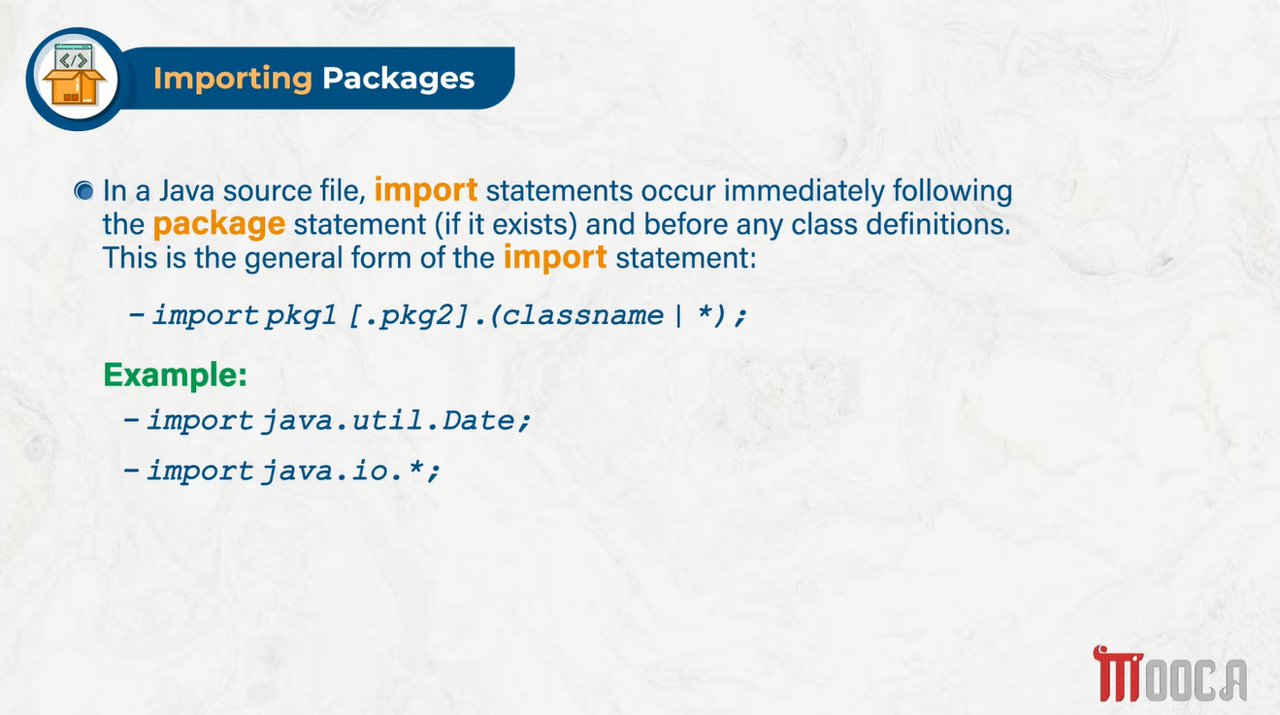

Slide 12
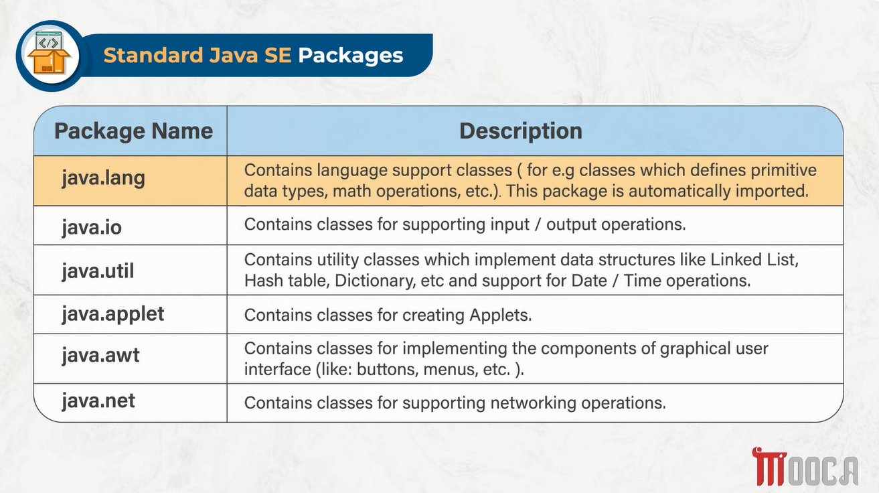



Slide 13
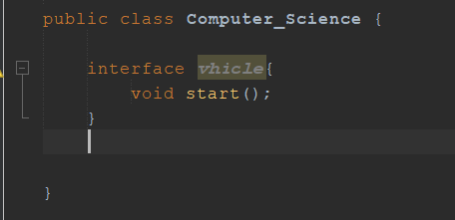

✍ What is an Interface
An interface defines a contract that a class must follow.
It specifies:
WHAT to do
not
HOW to do it

Slide 14
✍ Why Interfaces?
Imagine we have different classes:
Car
Bike
Bus
All of them need to:
start()
That's exactly what an Interface can do.

Slide 15
✍Interface vs Abstract Class
Interface and Abstract Class
Both can define abstract methods.
An abstract method:
abstract void start();
has:
Method signature
No implementation

Slide 16
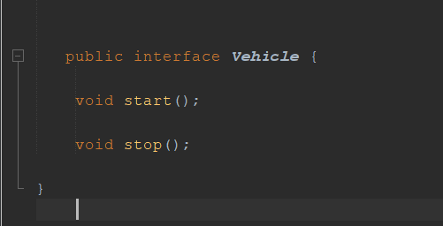
✍Interface Syntax
Define interface :
access_modifier interface InterfaceName {
method_declaration
};

Slide 17
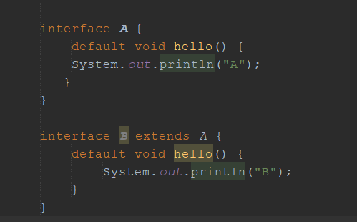
✍Extending Interfaces
Child interface inherits the default method.
It can override the default method.

Slide 18
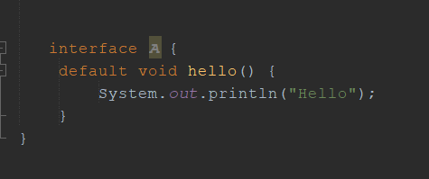
✍Default Methods
Method inside an interface with implementation.
Introduced in Java 8.
Classes can use it directly or override it.

Slide 19
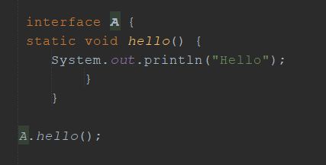


✍Static Methods
Allowed since Java 8.
Belong to the interface, not objects.
Called using the interface name.

Slide 20
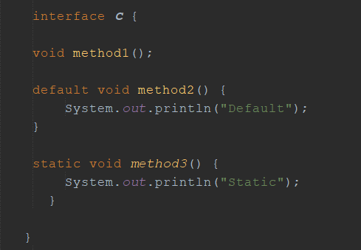


✍Types of Interface Methods
Abstract → no body → class must implement
Default → has body → class can use/override
Static → belongs to interface

Slide 21
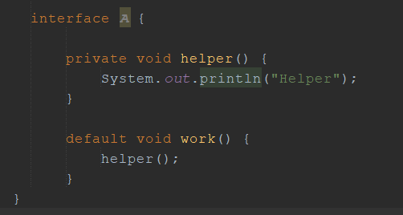
✍Private Interface Methods
Introduced in Java 9.
Used only inside the interface.
Mainly used as helper methods.
Reduce code duplication.

Slide 22
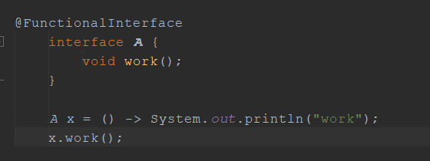
✍Functional Interfaces
Contains exactly one abstract method.
Can be used with Lambda Expressions.
@FunctionalInterface helps the compiler check it.

Slide 23
✍Functional Interfaces in Java
java.util.function
Common Functional Interfaces
Predicate
Consumer
Function
Supplier
UnaryOperator
BinaryOperator

Slide 24
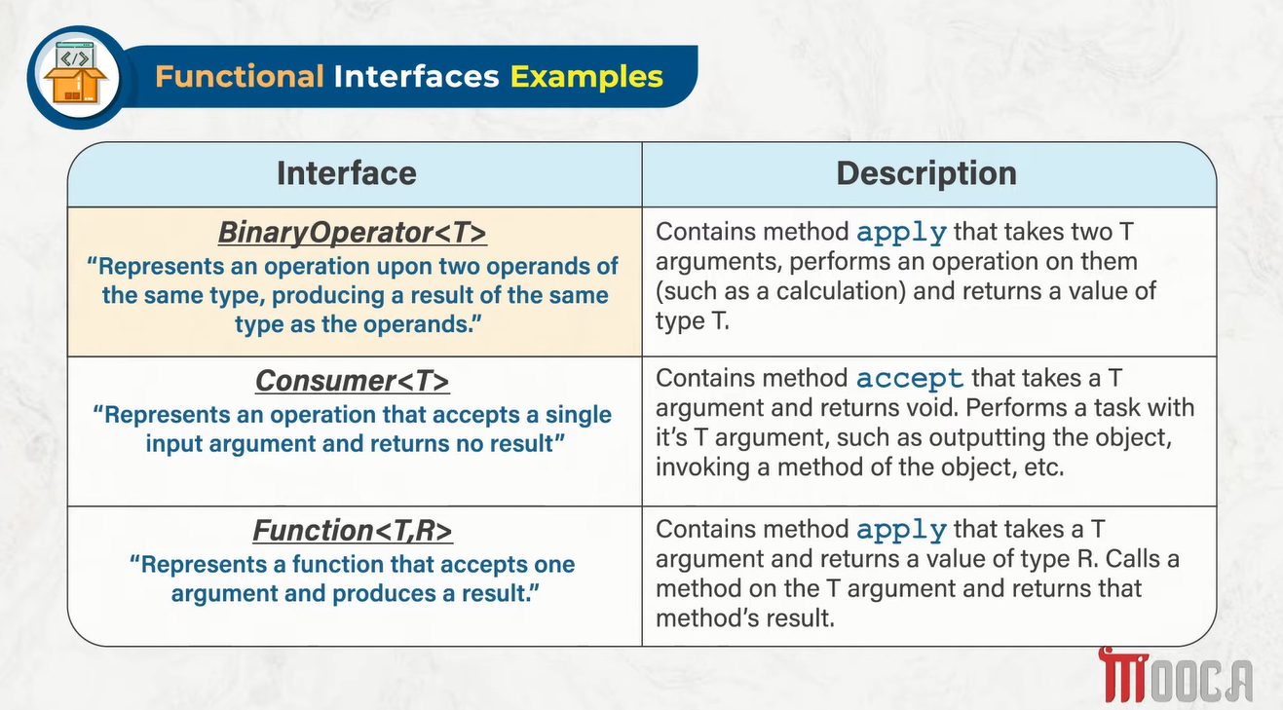


Slide 25
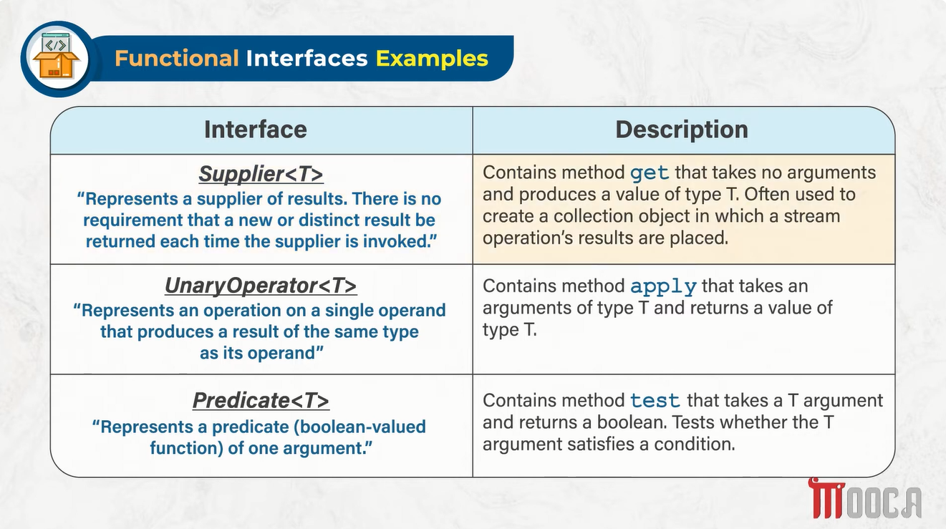

Slide 26
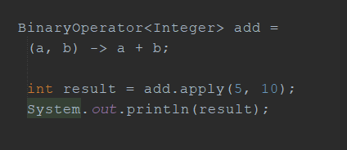
✍BinaryOperator / Consumer / Function
BinaryOperator : 2 inputs

Slide 27
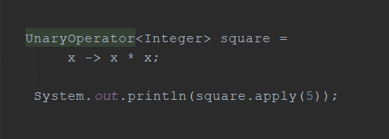
✍UnaryOperator
UnaryOperator : 1 input

Slide 28
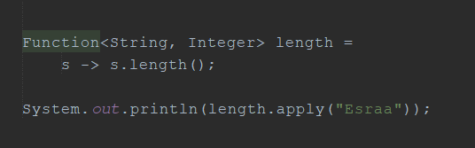
✍Function
Function :
Input Type
Different Output Type

Slide 29
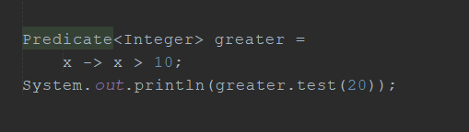
✍Predicate
Predicate:
Input
Question
true / false :

Slide 30
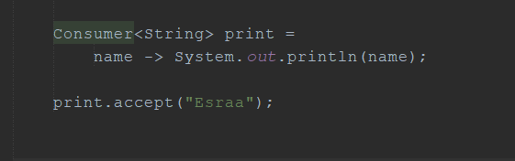
✍Consumer
Consumer:
one input
Performs an action on it.
Returns nothing
Method: accept()

Slide 31
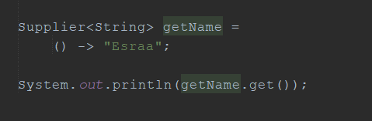
✍ Supplier
Supplier :
nothing
String

Slide 32
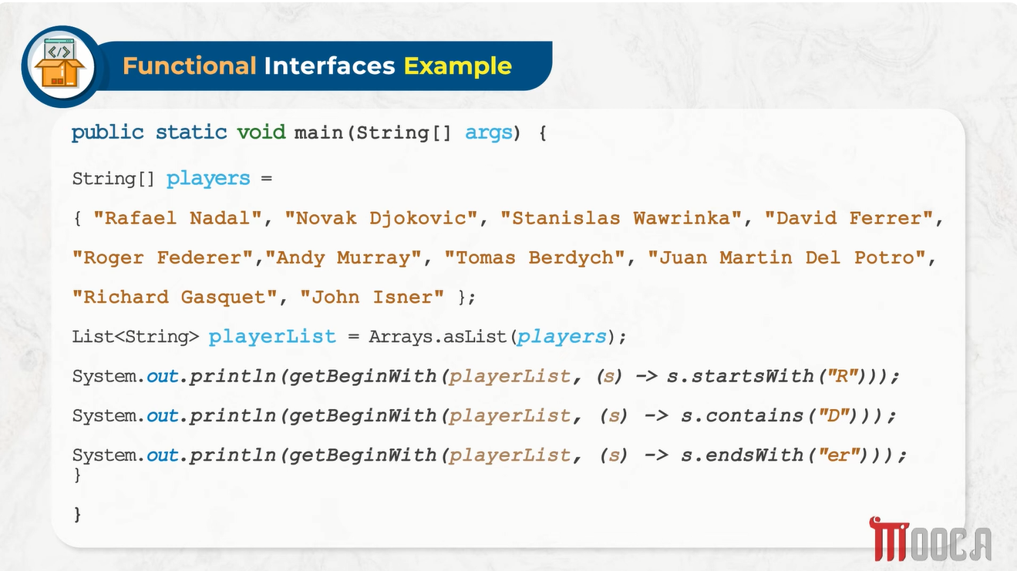

Slide 33
